Slide 1
Mass Media

Slide 2
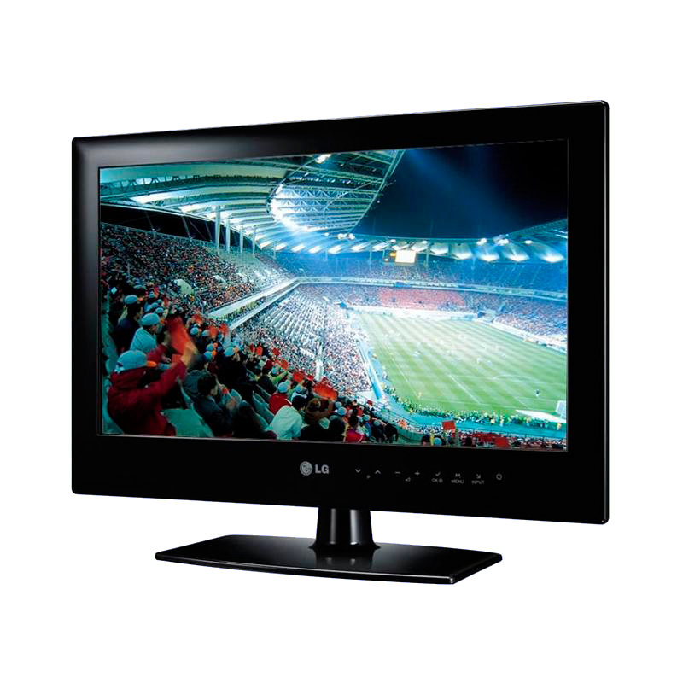
Television (satellite/cable) – broadcasting programmes for people to watch on they television sets.

Slide 3
Newspaper (daile/weekly) – a paper printed and sold with news, advertisement.

Slide 4
Tabloid – a newspaper with small pages, many pictures and little serious news

Slide 5
The Internet – a way to communicate using the computer.

Slide 6
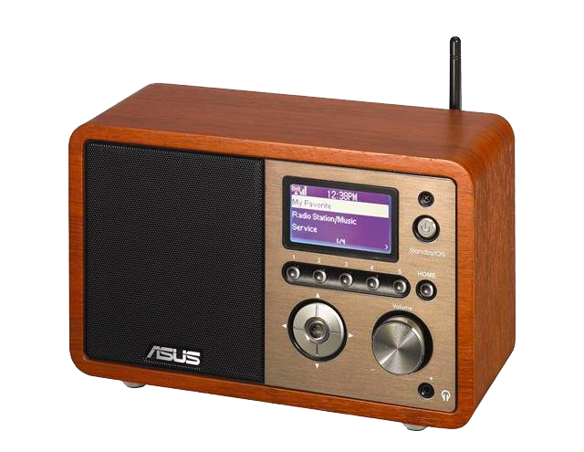
Radio – broadcasting proramms for people to listen to

Slide 7
Show
Drama
Cartoon
TV Programms
Game show
News
Documentary

Slide 8
TV Programmes
Documentary – a programme that is based on facts The news – a programme about the latest events.
Game show – a programme where people compete to win the game.
Cartoon – animated films for children and tale adults.
Show – a programme where people tell us about their personale life and problems.
Drama- a programme that tells us a story usully with some sad or tragic ending

